Slide 1
Spring Annotations

Slide 2
Spring @RestController
Introduced in Spring 4.0 to simplify the creation of RESTful APIs.
It is a combination of @Controller and @ResponseBody
The Controller class is annotated with @RestController, therefore, @ResponseBody is not required.
Each method of the Controller class automatically serializes (converts) the return objects to HttpResponse.
@RestController
@RequestMapping("posts-rest")
public class SimplePostRestController {
@GetMapping("/{id}", produces = "application/json")
public Post getPost(@PathVariable int id) {
return findPostById(id);
}
private post findPostById(int id) {
// ...
}
// with @Controller
@GetMapping("/{id}", produces = "application/json")
public @ResponseBody Post getPost(@PathVariable int id) {
//...
}
}

Slide 3
@RequestParam and @PathVariable
A query can have parameters, delimited by “?” in the url.
They are parsed automatically and passed to the method using the @RequestParam.
It is possible to use parts of the URL as a parameter of the method, using the @PathVariable annotation.
@GetMapping("/form")
public String setupForm(@RequestParam("formId") int formId) {
// When requesting /form?formId=1
// formId will get the value 1
}
@GetMapping("/form/{id}")
public String setupForm(@PathVariable long id) {
// When requesting /form/1
// formId will get the value 1
}

Slide 4
@RequestBody
By using @RequestBody with a method parameter, Spring will convert the body of the request, to the type specified for the parameter.
{
"title": "first post",
"author": "John Doe",
"text": "lorem ..."
}
@PostMapping("/posts")
public String addPost(@RequestBody Post post) {
// post will get the content of the body that is deserialized
// into an object of type Post
}

Slide 5
@ResponseBody
@ResponseBody tells the Controller that the returned object is automatically serialized into JSON and returned in the HttpResponse object.
Remember, we don't need to annotate @RestController controllers with the @ResponseBody annotation, Spring does this by default.
To go further: mediaType @ResponseBody public class
public class ResponseTransfer {
private String text;
// standard getters/setters
}
@PostMapping("/posts")
@ResponseBody
public ResponseTransfer addPost(@RequestBody Post post) {
return new ResponseTransfer("Thanks For Posting!!!");
}
// we can see the following response: {"text":"Thanks For Posting!!!"}

Slide 6
@ResponseStatus and HTTP Code
When an endpoint returns successfully, Spring returns an HTTP 200 (OK) response.
If we want to change the response status of a method, we use @ResponseStatus, which has two interchangeable arguments: code and value.
When setting the reason argument, Spring returns an HTML error page to the client, which is not suitable for REST APIs.
For more information lookup custom-http-status-code
@PostMapping(value = "/employee")
@ResponseStatus(HttpStatus.CREATED)
public Employee createEmployee(@RequestBody Employee employee)
{
return employeeRepository.save(employee);
}
@ResponseStatus(value = HttpStatus.FORBIDDEN,
reason="show a custom message")
public class ForbiddenException extends RuntimeException {}

Slide 7
ResponseEntity and HTTP Response
ResponseEntity represents the entire HTTP response: status code, headers, and body.
To use it, you have to send it back from endpoint, Spring does the rest.
ResponseEntity is a generic type. Therefore, any type can be used as the response body. body() returns a ResponseEntity and should be called last.
@GetMapping("/hello") ResponseEntity<String> hello() {
return new ResponseEntity<>("Hello World!",HttpStatus.OK);
}
@GetMapping("/authVerification")
ResponseEntity<String> verifyAccount(
@RequestParam("username") String name) {
return ResponseEntity.status(HttpStatus.OK)
.body("Your account is " +
authService.verifyAccount(name));
}

Slide 8
@RequestHeader et HTTP Headers
To access a specific header, configure @RequestHeader with the name of the header.
We use @RequestHeader without a specific name, to retrieve all the headers, or if we don't know which ones will be present.
You can use Map, MultiValueMap, HttpHeaders as type of variable.
@GetMapping("/greeting")
public ResponseEntity<String> greeting(
@RequestHeader("accept-language")
String language) {
// code that uses the language variable
return new ResponseEntity<String>(greeting, HttpStatus.OK);
}
@GetMapping("/listHeaders")
public ResponseEntity<String> listAllHeaders(
@RequestHeader Map<String, String> headers) {
return new ResponseEntity<String>(
String.format("Listed %d headers",headers.size()),
HttpStatus.OK
);
}

Slide 9
@RequestHeader et HTTP Headers
With HttpHeaders.
When designating a header specifically, the header is required by default. If it is not found in the request, the controller returns a 400 error.
We use optional-header and default-value for optional headers @RequestHeader et HTTP Header
@GetMapping("/getBaseUrl")
public ResponseEntity<String> getBaseUrl(
@RequestHeader HttpHeaders headers) {
InetSocketAddress host = headers.getHost();
//...
}
@GetMapping("/nonRequiredHeader")
public ResponseEntity<String> evaluateNonRequiredHeader(
@RequestHeader(value = "optional-header", required = false)
String optionalHeader) {
//...
}
@GetMapping("/default")
public ResponseEntity<String> evaluateDefaultHeaderValue(
@RequestHeader(value = "optional-header", defaultValue = "3600")
int optionalHeader) {
//...//...//...
}

Slide 10
Error Handling

Slide 11
Error Handling
Before Spring 3.2, @ExceptionHandler (for each controller) and HandlerExceptionResolver.
Since Spring 3.2, @ControllerAdvice (global)
Spring 5 introduces ResponseStatusException, for basic error handling in REST APIs.
@GetMapping(value = "/{id}")
public Post findById(@PathVariable("id") Long id,
HttpServletResponse response) {
try {
return Preconditions.checkNotNull(service.findOne(id));
}
catch (MyResourceNotFoundException exc) {
throw new ResponseStatusException(
HttpStatus.NOT_FOUND, "Post Not Found", exc);
}
}

Slide 12
Error Handling
Spring Boot implements ErrorController. It returns either an error page or a JSON for RESTful requests.
You can customize it, inheriting from BasicErrorController.
To know more:
Doc Spring
exception handling in Spring MVC
exception handling for REST with Spring
@Component
public class CustomErrorController extends BasicErrorController {
public CustomErrorController(ErrorAttributes errorAttributes) {
super(errorAttributes, new ErrorProperties());
}
@RequestMapping(produces = MediaType.APPLICATION_XML_VALUE)
public ResponseEntity<Map<String, Object>>
xmlError(HttpServletRequest request) {
// ...
}
}

Slide 13
Data Transfer Object

Slide 14
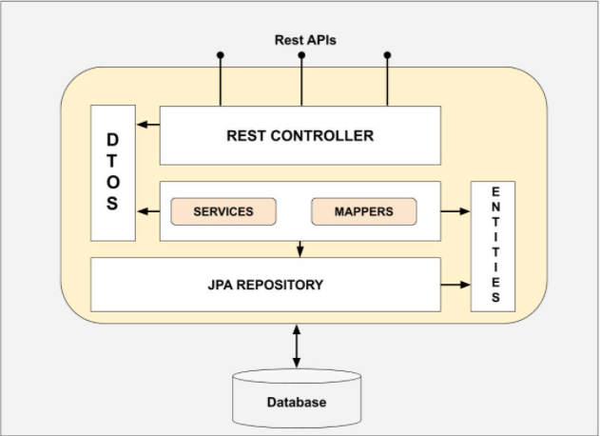
DTO
The DTO classes guarantee the decoupling of views (Views) and models (M, entities).
Pros:
Control the data sent to the front-end
Respect the principles of OOP
Facilitate the modification of Data modeling
Facilitate the maintenance and evolution of the code
Cons:
Increases the complexity of the code.
Possibility of duplicating the code
A possible loss of performance DTO

Slide 15
Conversion Entity-DTO
You can implement the ModelMapper library to perform the entity-DTO conversion.
Documentation
Repo Maven
// pom.xml
<dependency>
<groupId>org.modelmapper</groupId>
<artifactId>modelmapper</artifactId>
<version>2.3.5</version>
</dependency>
// Spring Configuration
@Bean
public ModelMapper modelMapper() {
return new ModelMapper();
}
// DTO
public class UserDto {
private Long id;
private String username;
private String role;
// standard getters and setters
}

Slide 16
Conversion Entity-DTO
@RestController
class PostRestController {
@Autowired
private ModelMapper modelMapper;
@GetMapping(value = "/{id}")
public UserDto getUser(@PathVariable("id") Long id) {
return convertToDto(userService.getUserById(id));
}
private PostDto convertToDto(Post post) {
PostDto postDto = modelMapper.map(post, PostDto.class);
// ...
return postDto;
}
private Post convertToEntity(PostDto postDto) throws ParseException {
Post post = modelMapper.map(postDto, Post.class);
// ...
return post;
}
}

Slide 17
Swagger 2

Slide 18
Swagger 2
Swagger allows you to generate detailed documentation in JSON format, meeting OpenAPI specifications.
In Spring 5 projects we use the library springfox.
Spring Boot provides springfox-boot-starter.
// pom.xml
<dependency>
<groupId>io.springfox</groupId>
<artifactId>springfox-swagger2</artifactId>
<version>2.9.2</version>
<scope>compile</scope>
</dependency>
<dependency>
<groupId>io.springfox</groupId>
<artifactId>springfox-swagger-ui</artifactId>
<version>2.9.2</version>
<scope>compile</scope>
</dependency>
<!-- For Spring Boot projects Only -->
<dependency>
<groupId>io.springfox</groupId>
<artifactId>springfox-boot-starter</artifactId>
<version>3.0.0</version>
</dependency>

Slide 19
Swagger 2
@Configuration
@EnableSwagger2
public class SwaggerConfig {
@Bean
public Docket productApi() {
return new Docket(DocumentationType.SWAGGER_2)
.select()
.apis(RequestHandlerSelectors.basePackage("myPackage.controllers")) // RequestHandlerSelectors.any()
.paths(PathSelectors.regex("/product.*")) // .paths(PathSelectors.any())
.build();
}
}
To go further:
Doc springfox
Tutorial 1
Tutorial 2

Slide 20
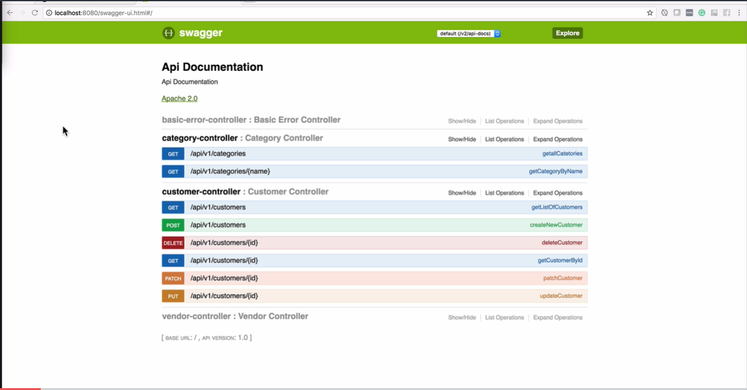
Swagger 2

Slide 21
Postman

Slide 22
Postman
A tool for testing APIs, which allows us to quickly and easily send REST, SOAP and GraphQL requests.
Installation
Documentation
Alternatives:
VS Code REST Client
IntelliJ HTTP Client
Insomnia

Slide 23
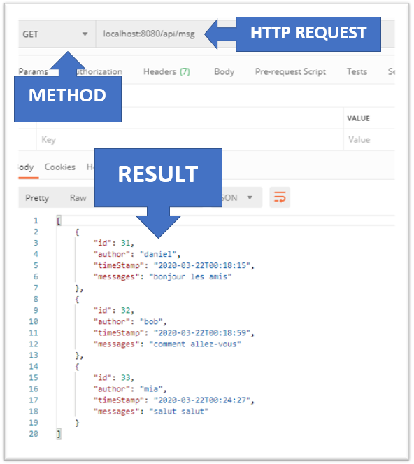
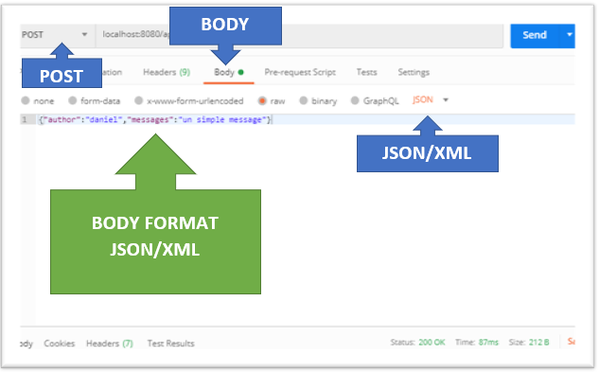
Postman

